Slide 1

PROJECT REVIEW VI Group 9
Sanjivani Rural Education Society’s
Sanjivani College of Engineering, Kopargaon-423603
(An Autonomous Institute Affiliated to Savitribai Phule Pune University, Pune)
NAAC ‘A’ Grade Accredited
Department of Information Technology
(UG program, NBA Accredited)
“Result Analysis and Visualization to Improve Decision Making for Educational Institutes.’’
Presented By:
Prajakta Kolse [UIT20F1036]
Raviraj Nehul [UIT20M1043]
Mitusha Pawar [UIT20F1046]
Savi Solanki [UIT20F1061]
Guided by:
Dr. C. D. Bawankar

Slide 2

Content
Problem Statement Abstract Introduction Literature Survey Methodology Design Proposed System Software Tools Result Conclusion Future Scope
2023-2024 Department of Information Technology

Slide 3



Problem Statement
Inefficient Traditional Methods:
Traditional result analysis methods are time-consuming and often provide limited insights.
Lack of Depth and Clarity:
Existing methods fail to deliver in-depth analysis and clear visualization of student performance data.
Absence of Real-Time Insights:
Inability to access real-time data hampers timely decision-making and interventions.
2023-2024 Department of Information Technology

Slide 4
Abstract
This project presents two distinct solutions for analyzing university exam results. The Django application manages student data and exam scores, providing detailed analytics on student performance, pass/fail rates, and trends. It supports academic planning and decision-making by offering insights into exam results at various levels departmental, course-specific, and subject-wise. Concurrently, Power BI is utilized to develop interactive dashboards for visualizing key performance indicators across departments, courses, and subjects. These dashboards enable quick and accurate analysis of exam results, facilitating data-driven decision-making and strategic planning within the university. Each solution Django and Power BI serves distinct purposes: Django for detailed data management and local analysis, and Power BI for visual reporting and broader insights across the university.
2023-2024 Department of Information Technology

Slide 5

Introduction
In today’s educational landscape, effectively analyzing student performance data is crucial for decision-making. Traditional methods often lack depth and real-time insights, hindering the identification of trends and areas needing improvement. This inefficiency affects education quality and student outcomes. To address these challenges, advanced data analysis and visualization techniques are needed. These can provide actionable insights, enabling educational institutes to make data-driven decisions that enhance teaching quality, student performance, and overall effectiveness.
2023-2024 Department of Information Technology

Slide 6
Literature Survey
S. No. | Author/ Authors, Year | Title | Journal | Source/ Publisher | Findings & Relevance | Research Gap
1 | S. B. Akki and M. N. Vijayalakshmi 2018 | Design of Dashboard for University Examination Result Analysis System | IEEE | 3rd International Conference on Computational Systems and Information Technology for Sustainable Solutions (CSITSS), Bengaluru, India, 2018 | The study demonstrates the significance of key performance indicators and actual case analysis and shows the use of data analytics and visualisation in EPC projects for efficient project management.. | A potential research gap lies in exploring the barriers to adopting data analytics in EPC projects and comparing the effectiveness of various analytics methods and tools in this context.
2 | Hafiz muhammad shakeel , shamaila iram, hussain al-aqrabi , tariq alsboui, and richard hill 2022 | A Comprehensive State-of-the-Art Survey on Data Visualization Tools: Research Developments, Challenges and Future Domain Specific Visualization Framework | IEEE | Department of Computer Science, University of Huddersfield, HD1 3DH Huddersfield, U.K | This research underscores the vital role of data visualization and the need for further exploration to bridge the knowledge gap and address challenges in various domains. | A research gap in the field of data visualization is the lack of a comprehensive study on state-of-the-art interactive visualization techniques, web-based tools, and performance improvement methods, along with their theoretical foundations.
2023-2024 Department of Information Technology

Slide 7
Literature Survey
S. No. | Author/ Authors, Year | Title | Journal | Source/ Publisher | Findings & Relevance | Research Gap
3 | Mandava Geetha Bhargava, K. Tara Phani Surya Kiran & Duvvada Rajeswara Rao 2021 | Analysis and Design of Visualization of Educational Institution Database using Power BI Tool | Global Journals | Global Journals | It emphasises the expanding significance of data visualisation across a range of disciplines, but especially in business intelligence and analytics. | A research gap could be exploring the challenges and specific benefits of using Power BI for educational data analysis.
4 | Amrapali Bansal, A. K. Upadhyay 2017 | Microsoft Power BI | International Journal of Soft Computing and Engineering | International Journal of Soft Computing and Engineering | The study demonstrates the successful implementation of a Self-service Business Intelligence (BI) solution using Microsoft Power BI for efficient and data-driven decision-making. | A potential research gap could involve further investigation into the challenges and real-world impact of implementing Self-service BI in dynamic business environments.
2023-2024 Department of Information Technology

Slide 8
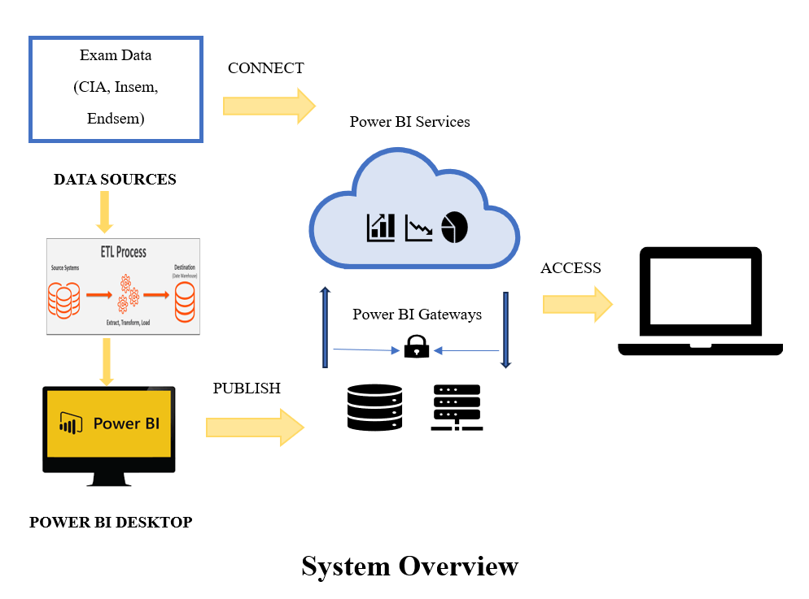
Design
2023-2024 Department of Information Technology

Slide 9
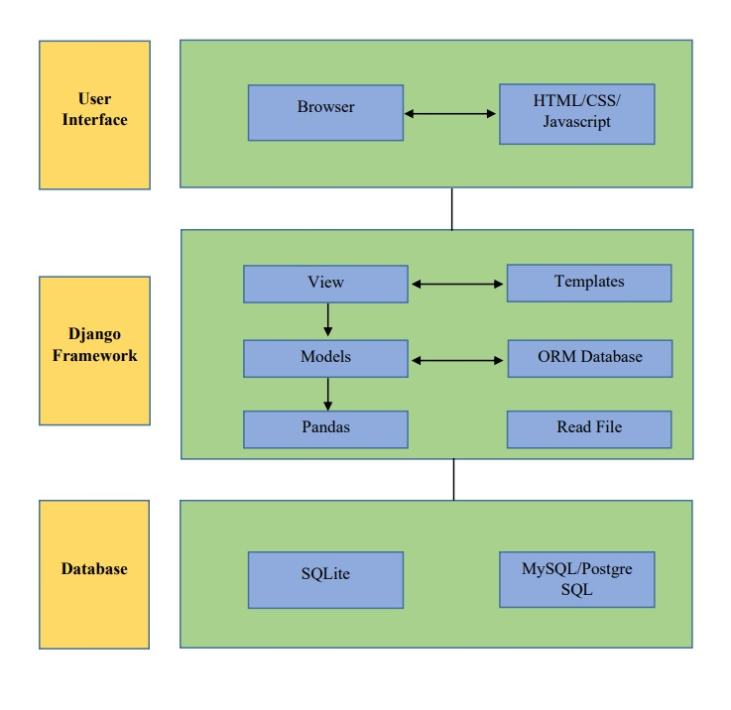
Design
Django Architecture
2023-2024 Department of Information Technology

Slide 10
Proposed System
Division-wise All Clear Students:- Visual representation of the sum of all-clear students across different divisions using a Donut Chart.
Examination Statistics:- Number of students appeared, number of students passed (all clear), number of students failed, number of students with A.T.K.T, all presented in a clear and concise column chart format.
Overall Toppers:- Visualization of overall toppers using a Matrix Chart, providing a comprehensive view of top-performing students across all subjects.
Subject-wise Performance:- Displaying subject-wise information in numbers, sum of pass students for each subject, sum of failed students for each subject.
2023-2024 Department of Information Technology

Slide 11
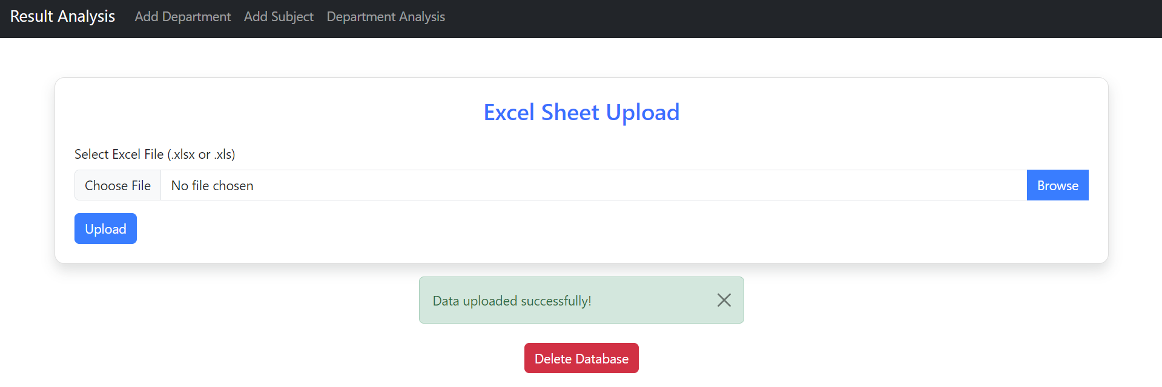
Proposed System
2023-2024 Department of Information Technology

Slide 12
Tools
Hardware Requirements:
1. Computer -Internet Connection, External Storage
Software Requirements:
Django version 5.0.2
Power BI Desktop
Python 3.11.5
SQLite
2023-2024 Department of Information Technology

Slide 13
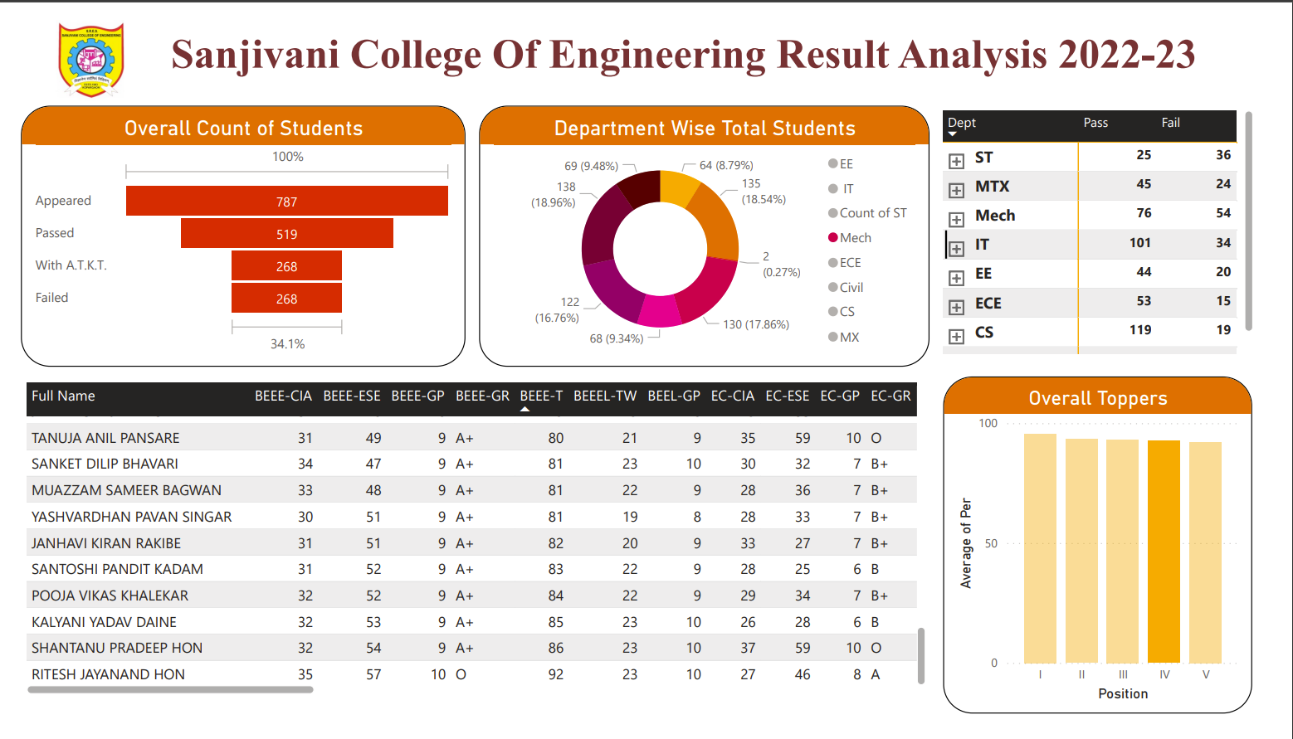
RESULT
2023-2024 Department of Information Technology

Slide 14
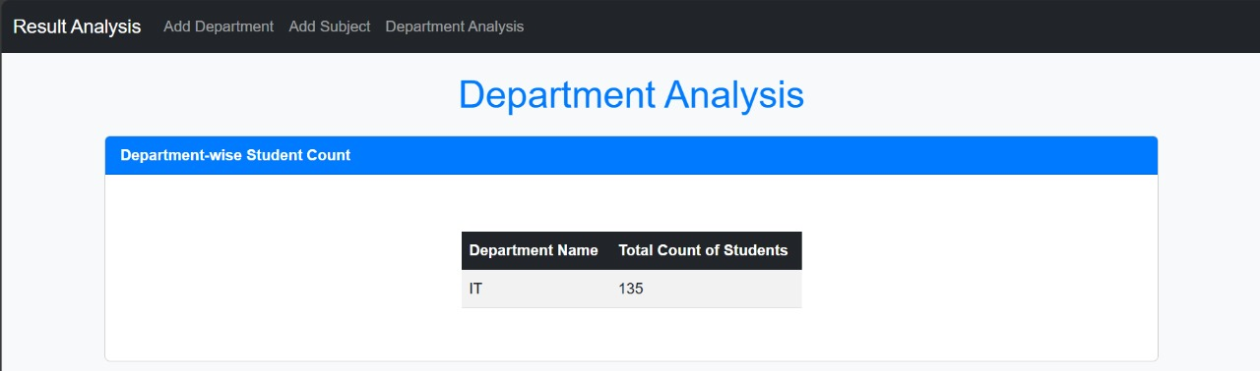
RESULT
2023-2024 Department of Information Technology

Slide 15
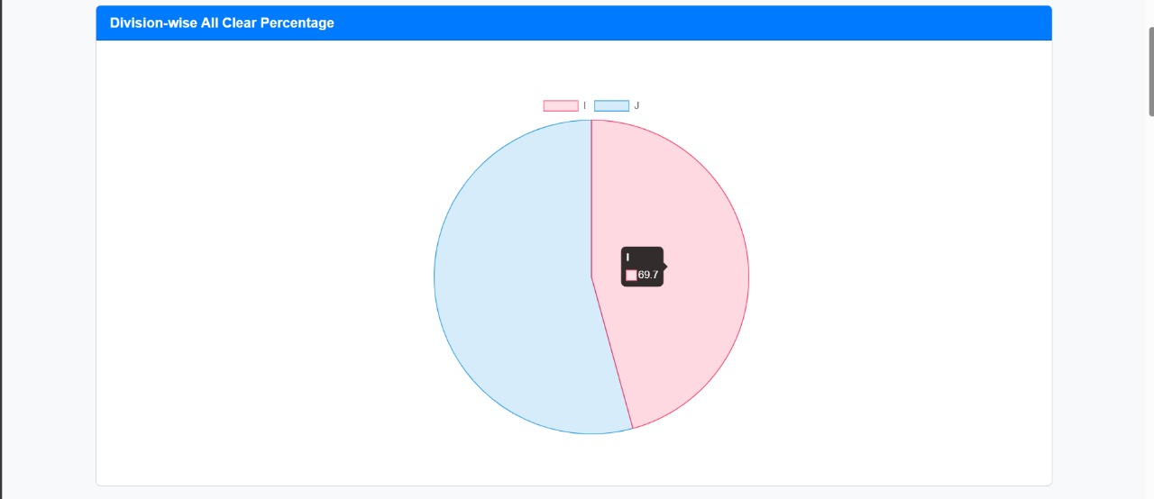
RESULT
2023-2024 Department of Information Technology

Slide 16
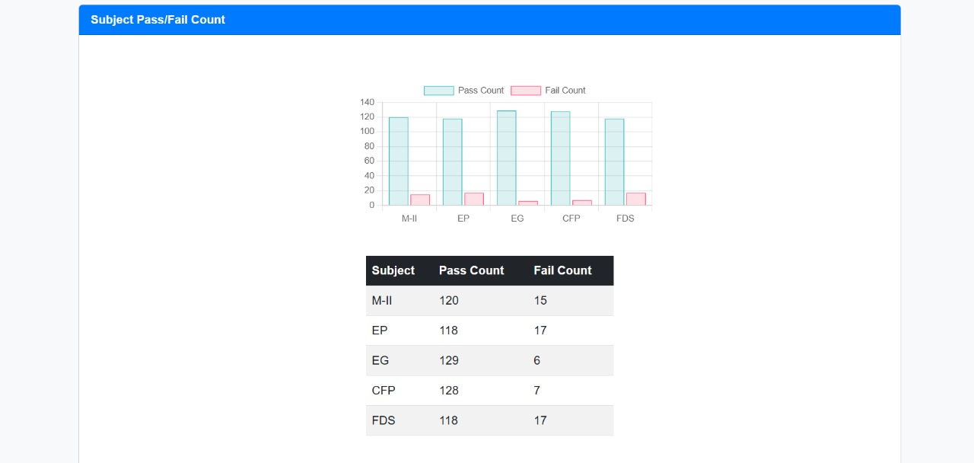
RESULT
2023-2024 Department of Information Technology

Slide 17
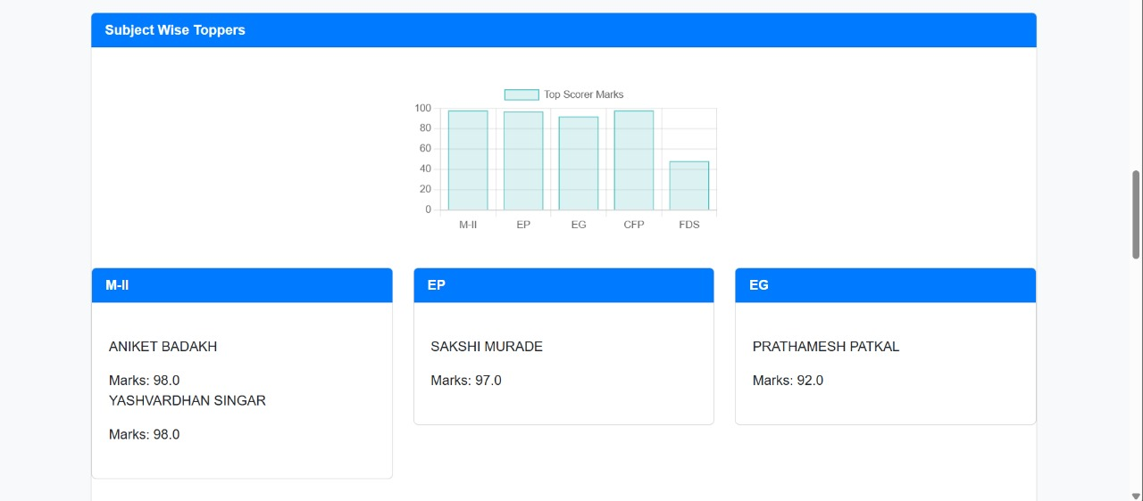
RESULT
2023-2024 Department of Information Technology

Slide 18
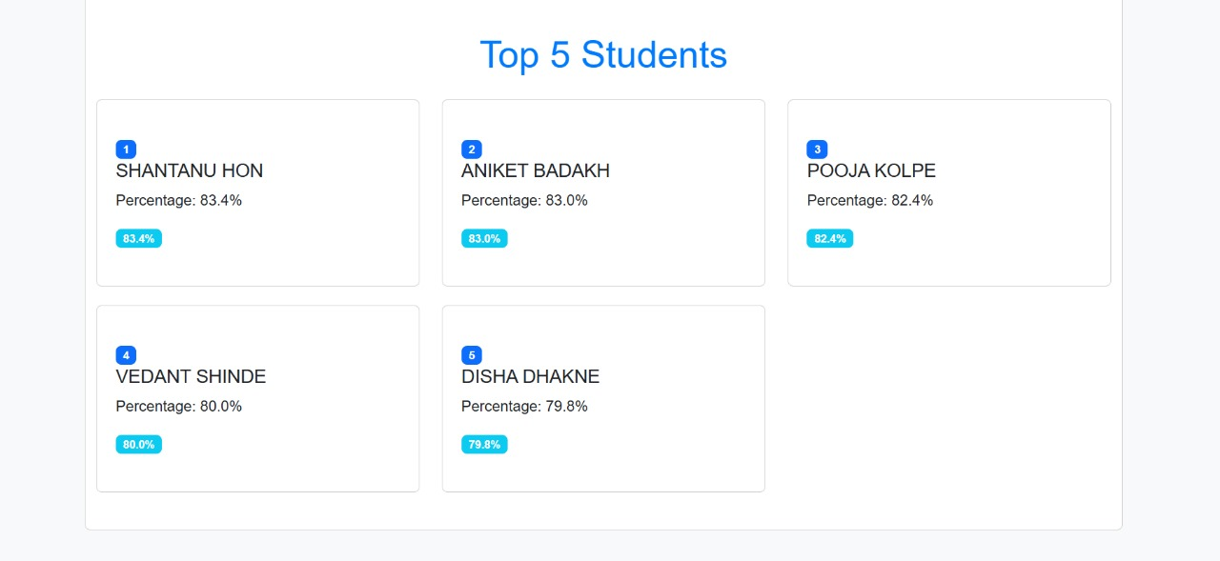
RESULT
2023-2024 Department of Information Technology

Slide 19
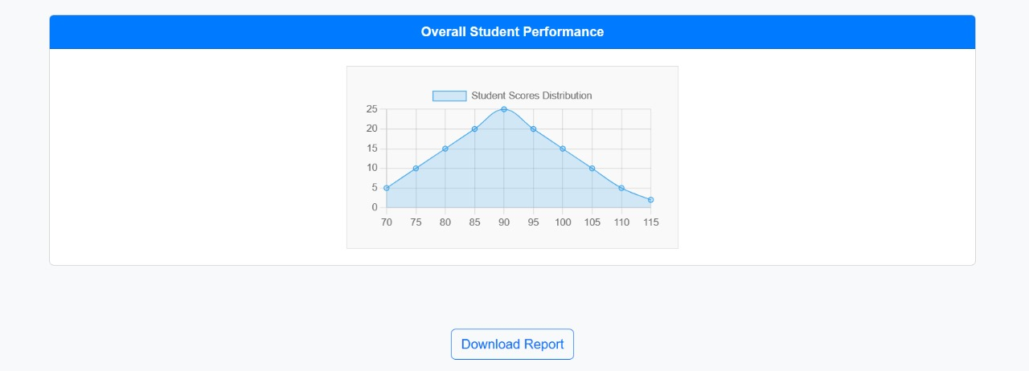
RESULT
2023-2024 Department of Information Technology

Slide 20
Future Scope
Predictive analytics:
The integration of predictive analytics algorithms Dashboard prediction can enable establishments to are expecting exam effects based totally on ancient records, developments in pupil overall performance and different relevant factors.
Machine gaining knowledge of and AI integration:
Leveraging device mastering and artificial intelligence can in addition enhance dashboard skills with the aid of imparting advanced statistics analytics, visualization personalized format and pointers
Mobile Accessibility and Personalization:
Developing a mobile model of your dashboard and implementing a custom person interface can boom accessibility and value to be used via stakeholders including faculty, college students, and directors.
Continuous Improvement and Feedback Mechanism:
Implementing a feedback mechanism in the dashboard allows stakeholders to offer feedback on usability, functionality, and relevance platform angle.
2023-2024 Department of Information Technology

Slide 21
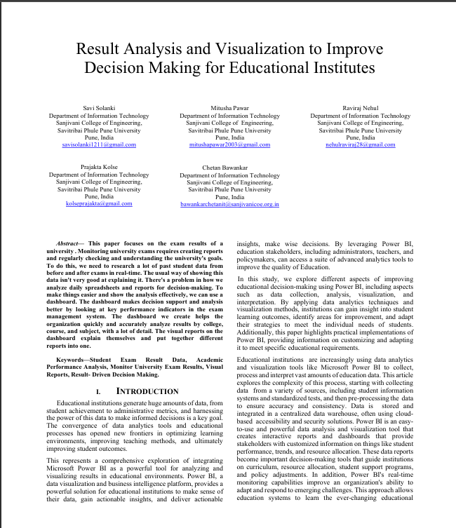
Research Paper
2023-2024 Department of Information Technology

Slide 22
Conclusion
In Conclusion, Implementing advanced data analysis and visualization techniques in educational institutes can revolutionize the utilization of student performance data. These tools provide clear, actionable insights, enabling educators and administrators to make informed, data-driven decisions. This approach not only enhances teaching quality and improves student outcomes but also strengthens overall institutional effectiveness. By identifying trends, pinpointing areas needing improvement, and facilitating real-time interventions, these techniques help institutes become more responsive and adaptive. Ultimately, using advanced data analysis and visualization creates a better learning environment. This helps schools adapt and succeed as education changes, making sure students get the best possible education suited to their needs.
2023-2024 Department of Information Technology

Slide 23

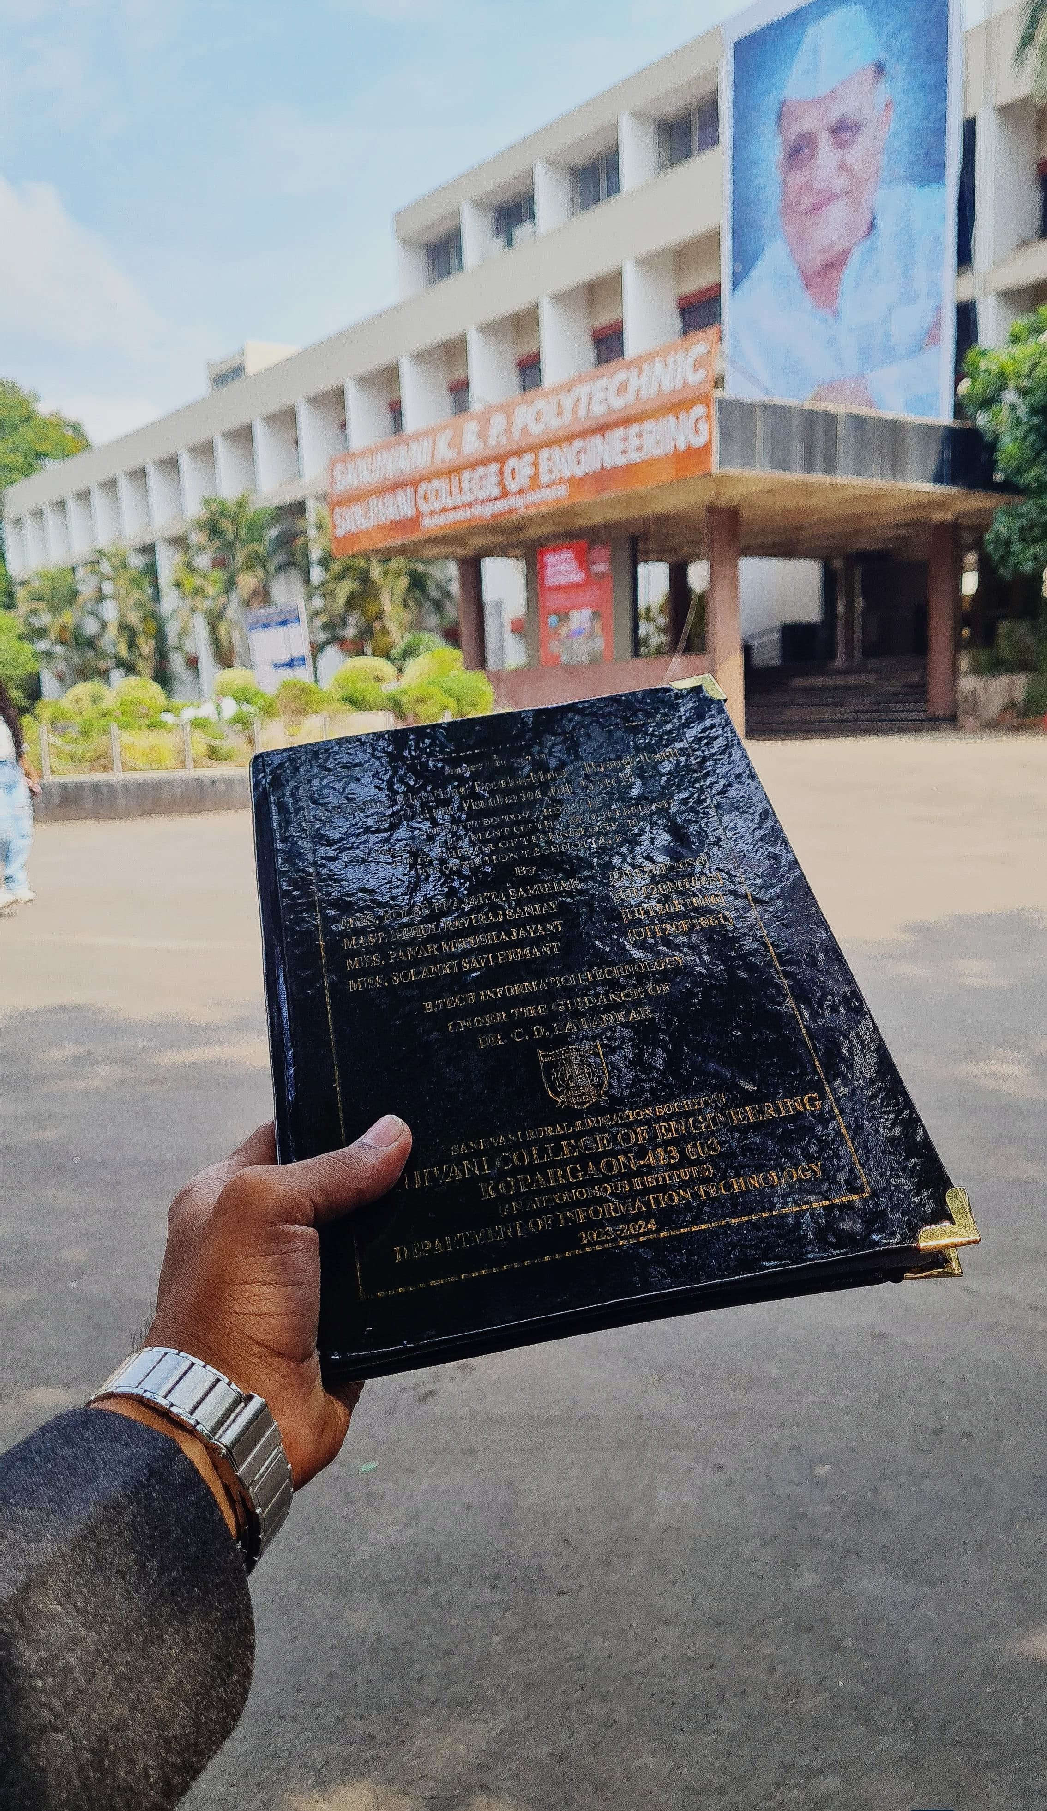
2023-2024 Department of Information Technology

